Slide 1
An Analysis of Winning in College Football
Joey Rheaume, Rodrigo Lara, Samuel Zhang, Steven Orbain

Slide 2
Goal
Main question
What aspects of a team are most important in winning college football games?
Goal
Observe the numerous range of statistics to determine which ones are most important to winning games and to qualitatively determine what aspect of football (offense, defense, special teams, etc.) mattered most
Procedure
Observe statistics based on different aspects
Create plots and models
Qualitatively interpret illustrations and models

Slide 3
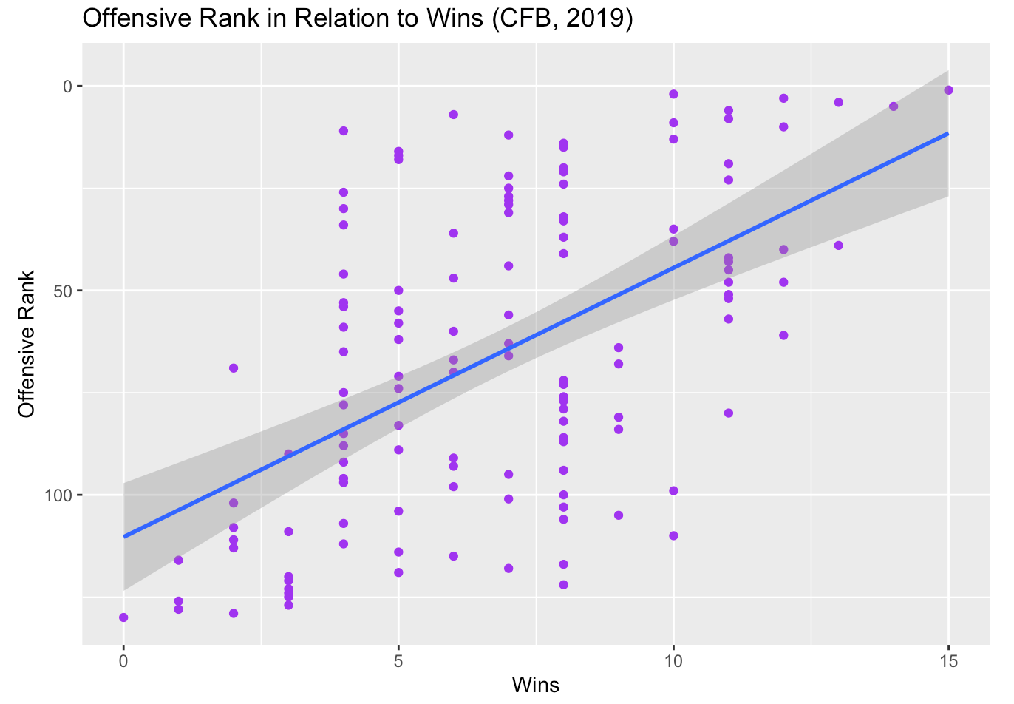
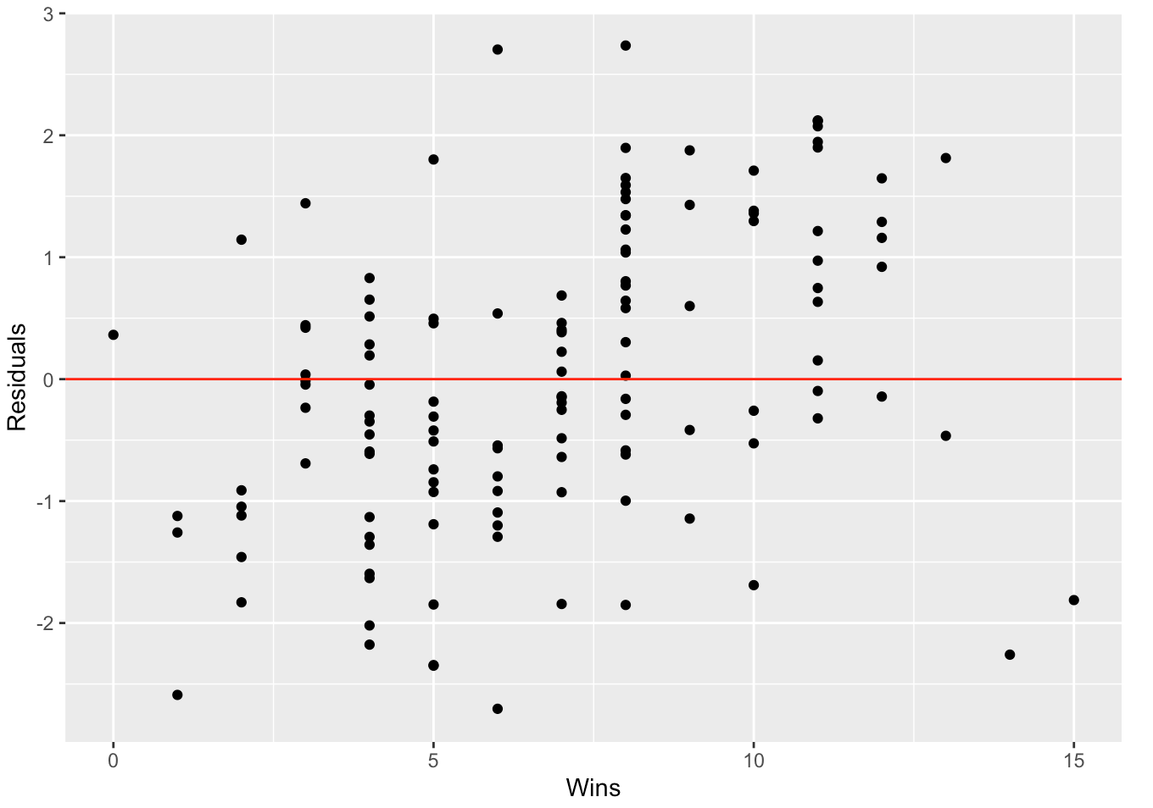
Results (Offense)
Top plot
Purple dots represent each team, blue line represents the best-fit
Showcases a strong linear relationship between the offensive rank and wins
Bottom plot
Residuals of regression model
Equal dispersion above and below line proves appropriate model for data
Based on offensive yards, TDs, rank, plays, first downs, scoring rank, & turnover margin
84% adj-R²

Slide 4
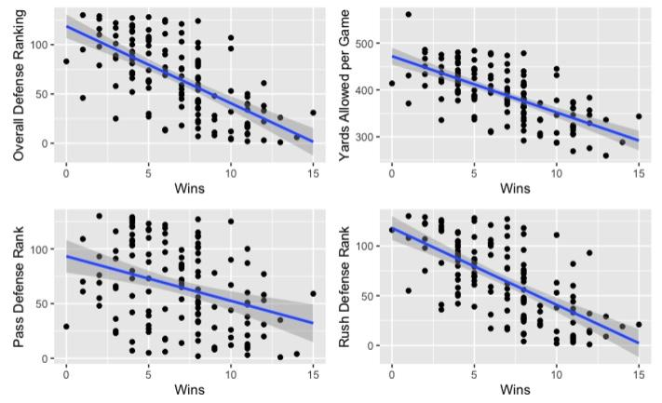
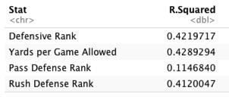
Results (Defense)
Clear linear correlation between all plots
All graphs are based on rankings so closer to zero the better and farthest right have most wins
Not all teams play same level of competition so leads to not so high r-squared values but values around 42 are significant enough to represent a correlation in this situation
Plots represent Overall Defensive Ranking (Top Left), Yards Allowed per Game (Top Right) , Pass Defense Rank (Bottom Left) and Rush Defense Rank (Bottom Right) vs the number of wins for a team

Slide 5
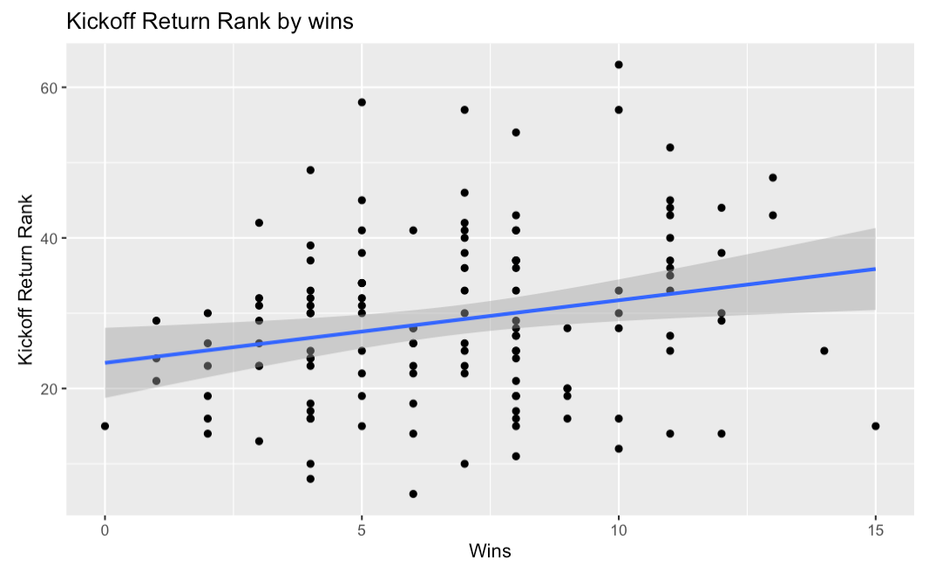
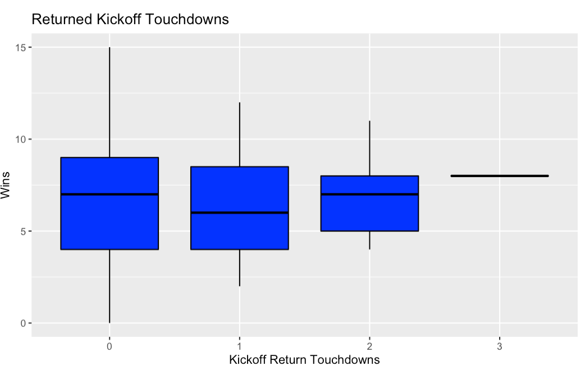
Results (Special Teams)
Plot relation between Kickoff Return Rank and Wins.
Dots represent each teams.
The greater the rank the greater the wins.
Boxplot relation between Returned Kickoff Touchdowns and Wins.
Surprisingly the team with most wins of the season didn’t make a single RKT
Doesn’t have much of an impact on victory probability.

Slide 6
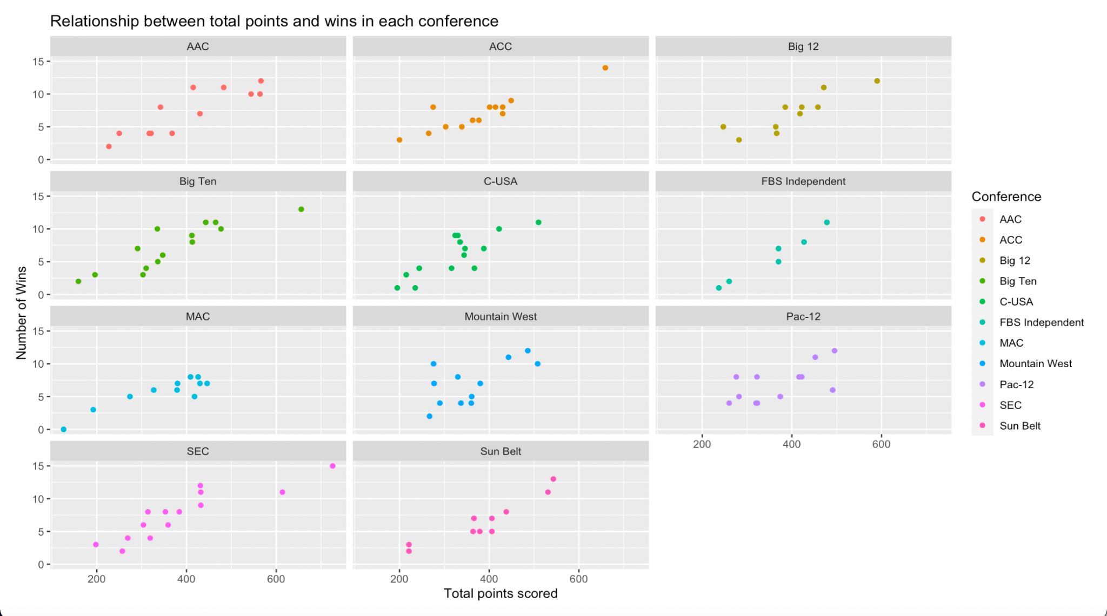
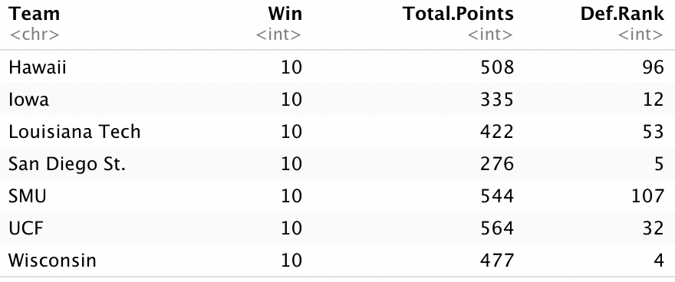
Relationship between points scored and wins in each conference
Analysis through conference perspective.
The plots show a positive relationship between total points scored and wins, except conference Mountain West.
Especially San Diego State university in Mountain West, they won 10 games out of 13 games by only scored 276 points which is relatively low compared to other teams that also won 10 games.

Slide 7
Conclusion
Which aspect mattered most?
Overall offense and defense performance seems to be the most important aspects to win games, meanwhile, special teams doesn’t seem to have that big of an impact on winning probability.
Which linear models showcased the best correlation with winning?
Offense and defense linear models seem to showcase the best correlation with winning, there must be an equally good balance between them to achieve a victory in games.
Are there any possible improvements to be made?
Plotting techniques are limited and data is limited to one year

Slide 8
References
https://www.kaggle.com/jeffgallini/college-football-team-stats-2019
STT 180 Slides

